Slide 1
Comparison between GWAS sumstats and Finemapping results
1. The pseudo-Manhattan plot includes only variants within the 95% credible set, with the x-axis representing chromosome and variant position, and the y-axis indicating the posterior inclusion probability (PIP). A reference line was drawn at PIP = 0.1.
2. In parallel, a genome-wide Manhattan plot based on raw GWAS summary statistics includes a Bonferroni-corrected significance threshold.
3. The two plots reveal consistent signals at the block level across all traits, providing support for the quality of the fine-mapping results.

Slide 2
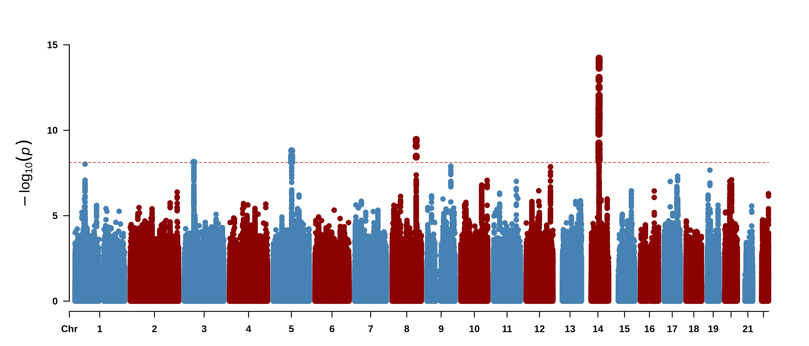
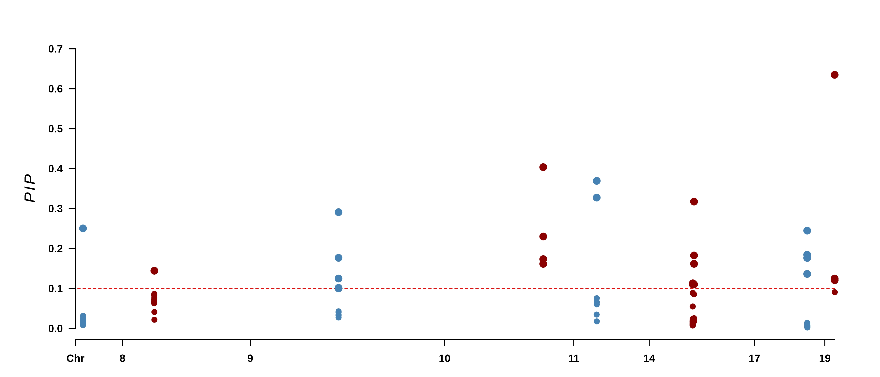
AD1
chr14_56126490_58669547 & chr14_58669547_61213190
chr19_12408772_15537337
chr10_130017190_130891275
chr1_50179506_54277735
chr9_116251953_117124386
chr17_69532703_70743921
chr8_41148214_42617647
chr11_30037956_32009579

Slide 3
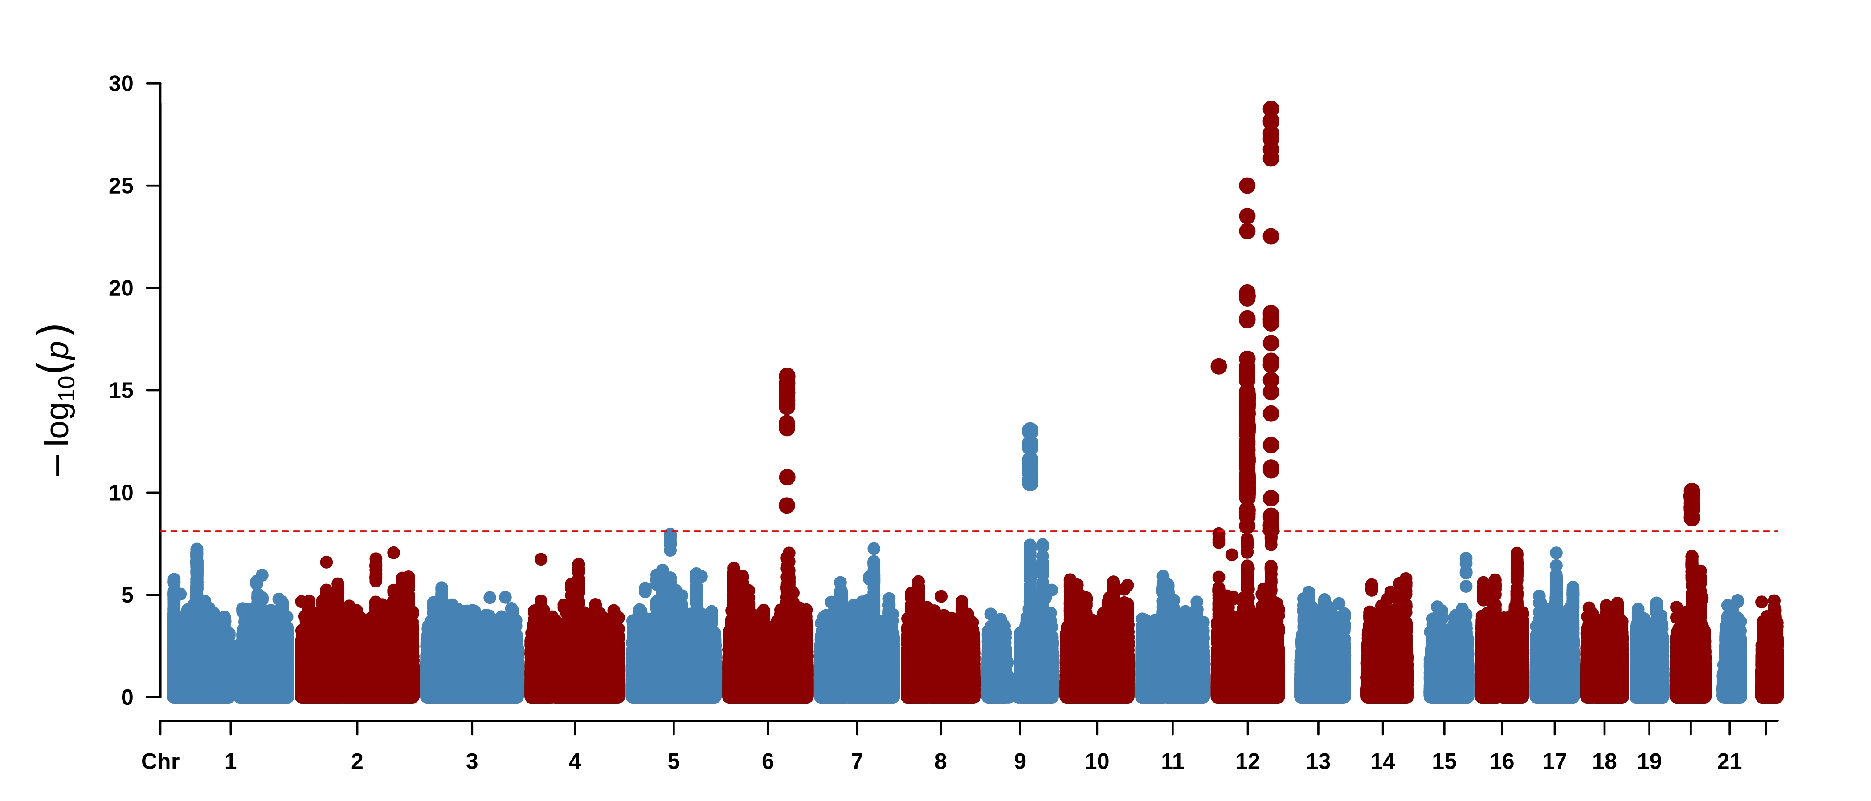
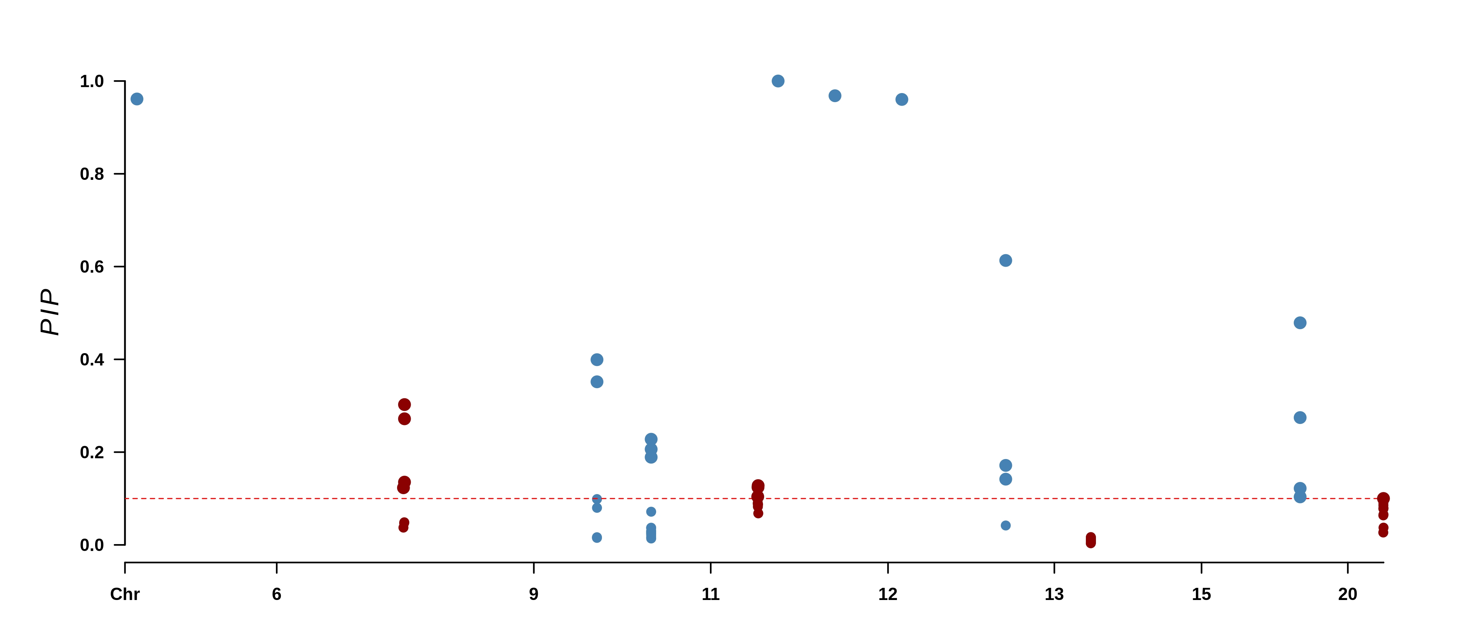
AD2
chr12_3219245_4882038
chr12_30570684_32921536
chr12_3219245_4882038
chr4_20819487_22317731
chr9_116251953_117124386
chr12_115165608_117668628
chr15_97384023_99087254
chr6_122787546_128506682
chr9_87677148_89739207
chr11_46916060_49936088
chr13_35472583_36923754
chr20_32060775_36429279

Slide 4
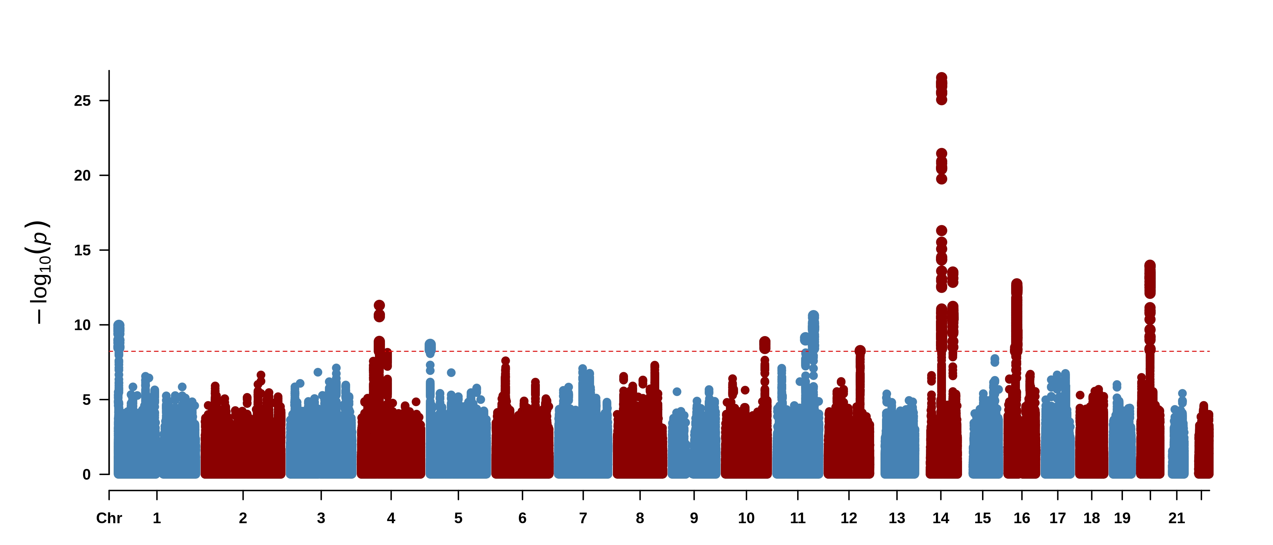
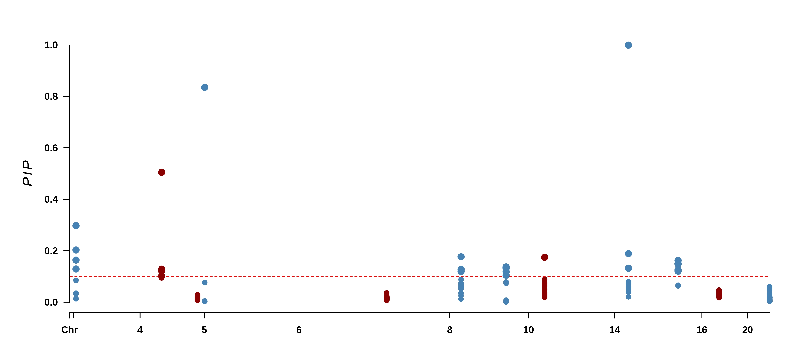
Aging1
chr14_53697988_56126490
chr5_11875_982414
chr1_2888443_4320284
chr8_81104029_82815761
chr4_55420021_58069173
chr8_48677154_50550619
chr10_23053090_24429720
chr4_81722770_83364947
chr14_90480460_92293029
chr6_122787546_128506682
chr16_24006835_25479836
chr20_25046442_32060775

Slide 5
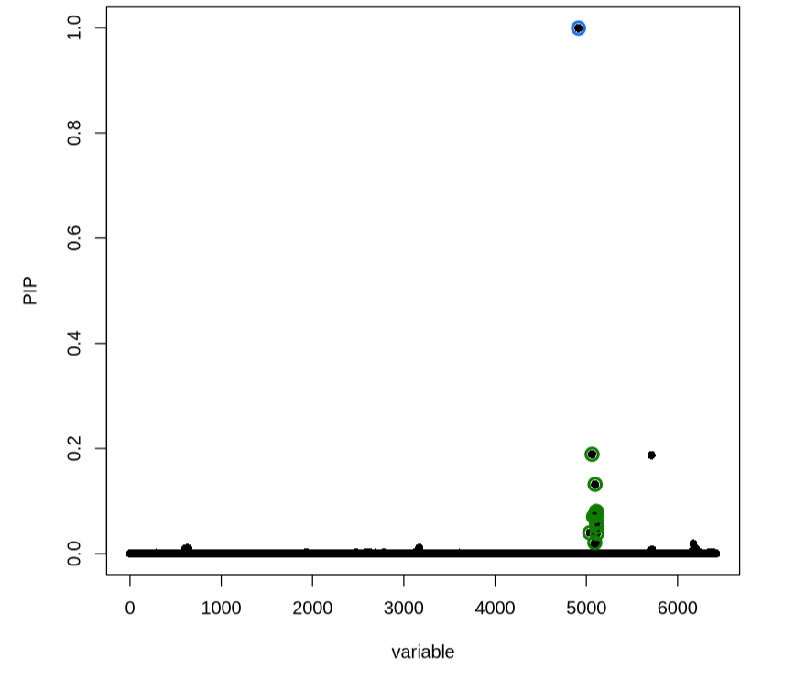
SuSiE PIP plot for Aging1 , chr14_53697988_56126490

Slide 6
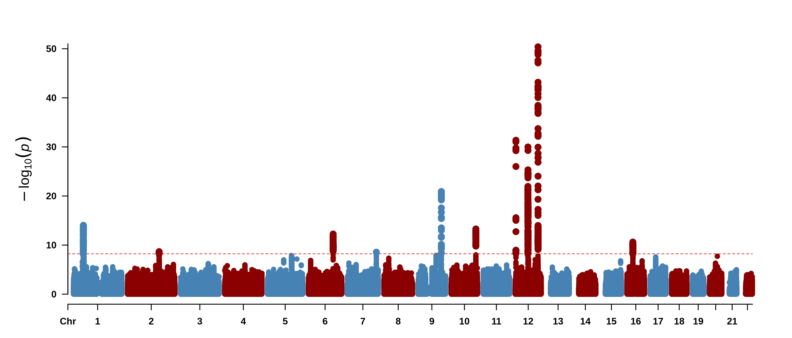
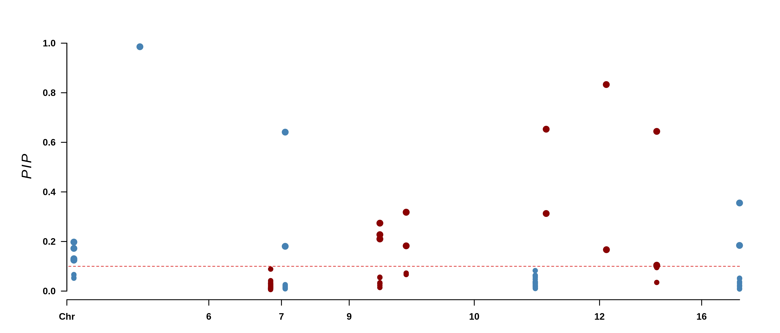
Aging2
chr12_61991992_65677087
chr12_3219245_4882038
chr12_115165608_117668628
chr5_149895776_152257891
chr7_6928965_7769511
chr9_116251953_117124386
chr16_76023784_77705911
chr9_87677148_89739207
chr5_81766514_84011262
chr10_123788803_125506866
chr6_122787546_128506682

Slide 7
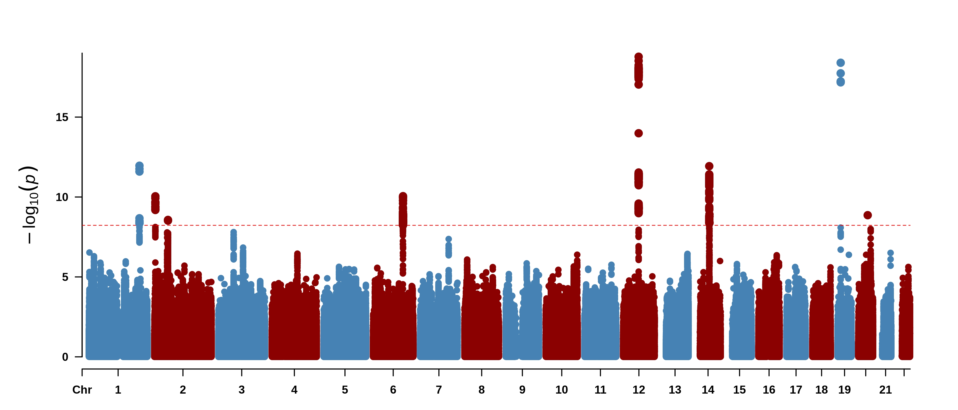
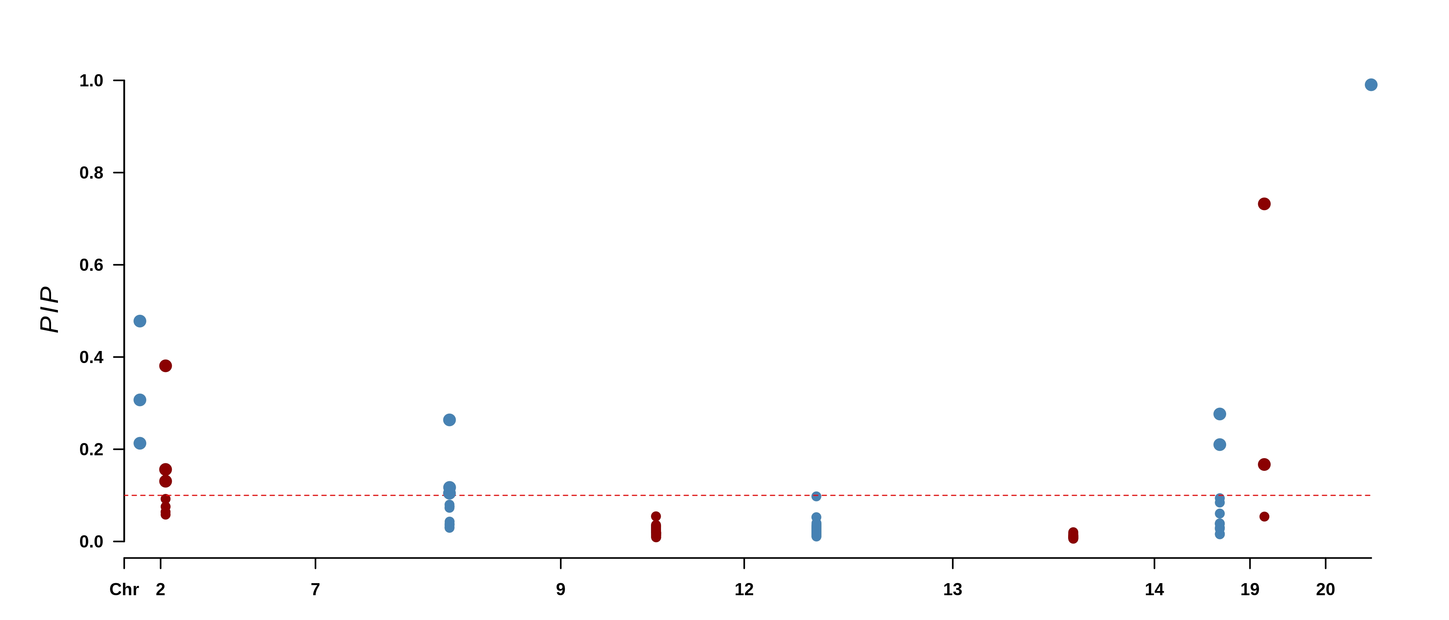
Aging3
chr1_214114077_215979204
chr20_40697409_42726168
chr2_3926189_5567778
chr19_12408772_15537337
chr9_84834158_86412165
chr12_61991992_65677087
chr14_58669547_61213190
chr7_118713025_122731183
chr13_108056156_109536072

Slide 8
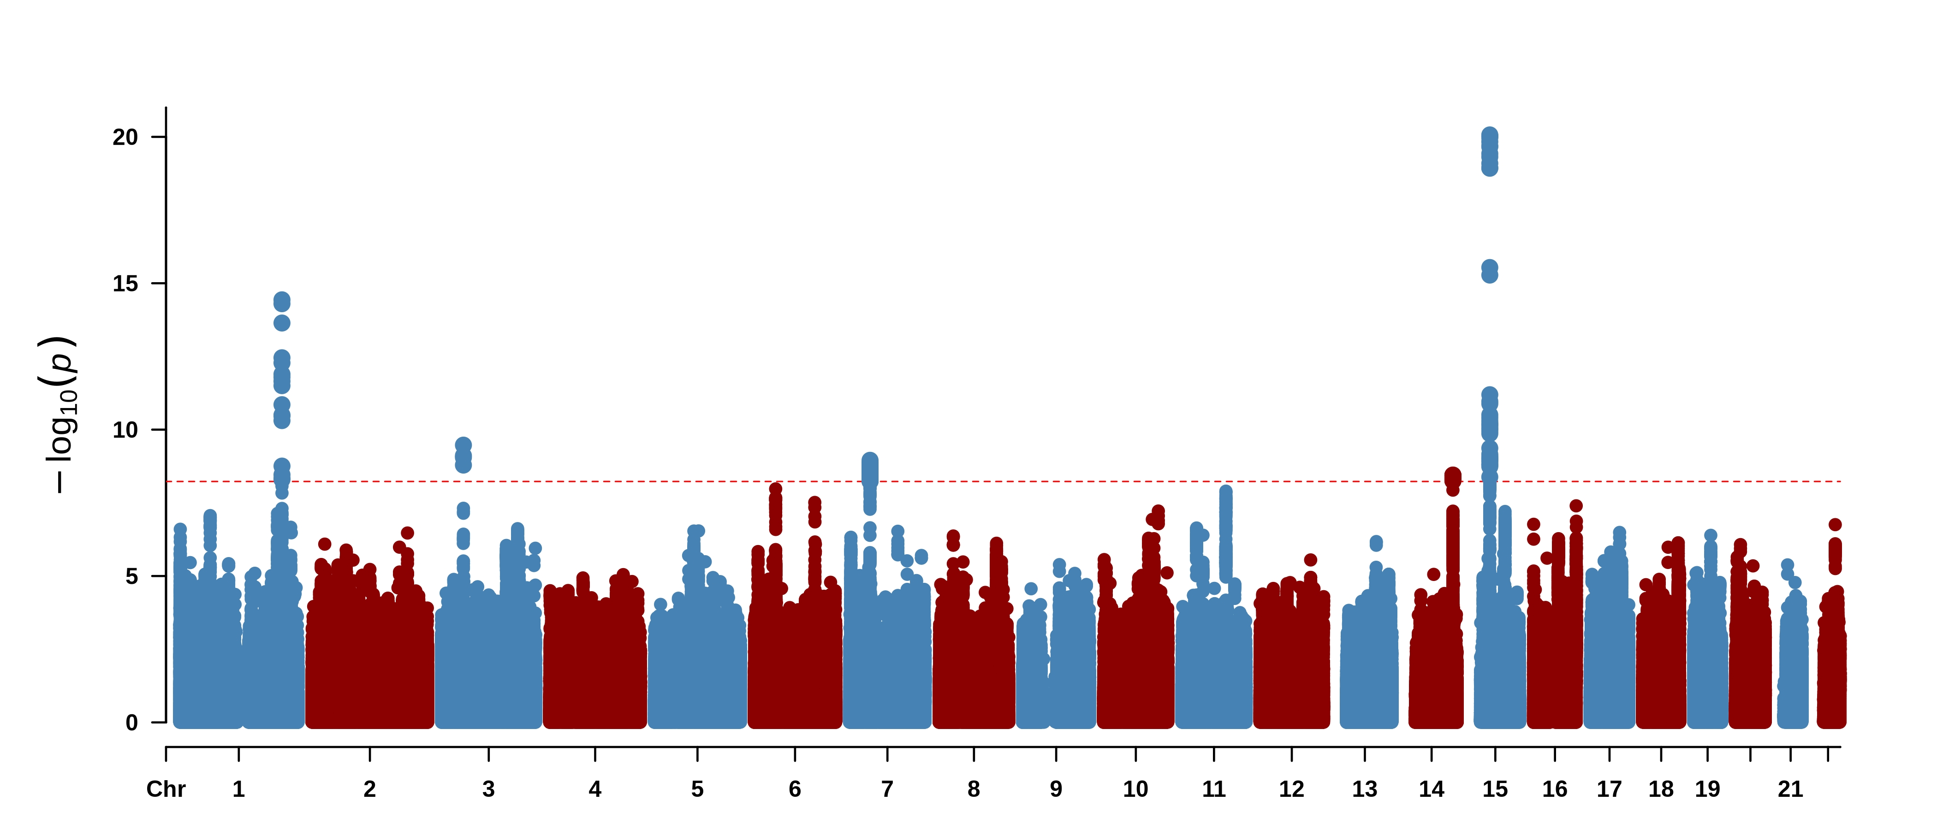
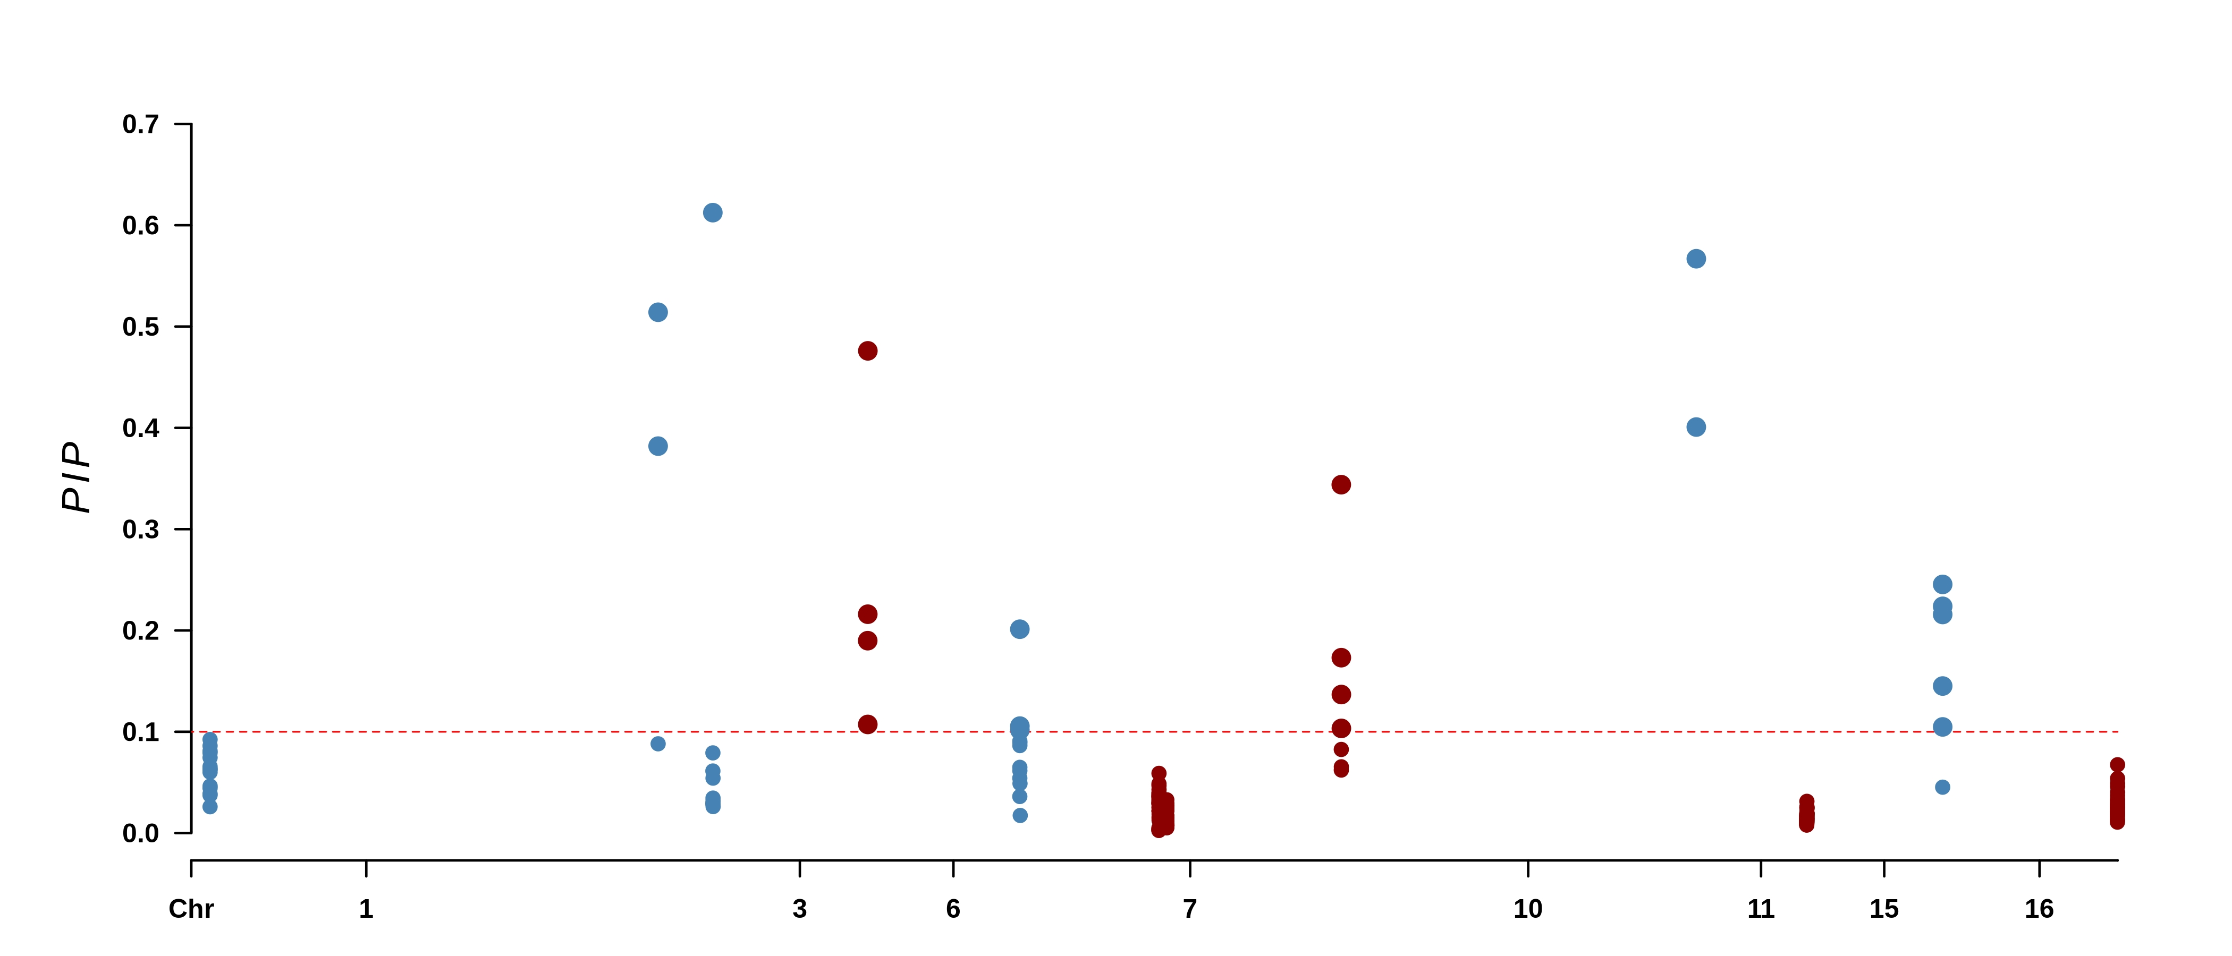
Aging4
chr3_45108216_47545024
chr7_101733715_103940775
chr10_109887976_113830418
chr1_233234629_234364329
chr6_43914875_45129743
chr15_38036498_39914612
chr1_214114077_215979204
chr7_38565649_41703696
chr1_63330290_66474395
chr11_30037956_32009579
chr16_51830934_54306975
chr7_41703696_43119648

Slide 9
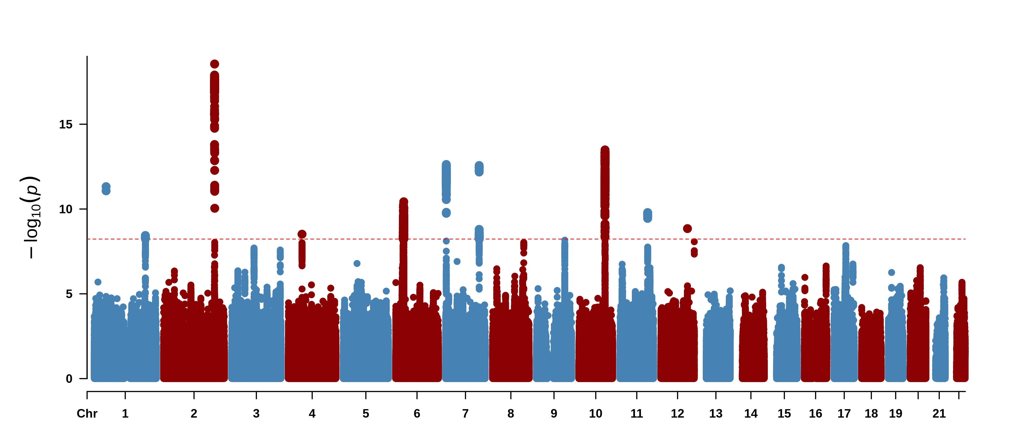
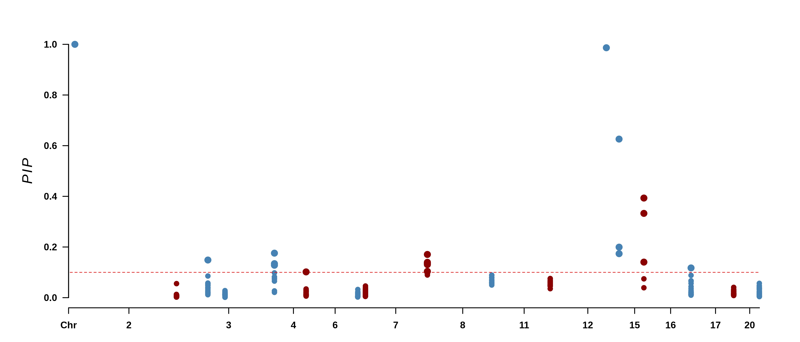
Aging5
chr12_105830574_109677898
chr1_44020567_47757518
chr15_38036498_39914612
chr3_194286613_196135651
chr3_88209300_94537986
chr7_134051635_135906335
chr4_53515952_55420021
chr7_2640020_3986377
chr12_132283870_133264718
chr6_95271417_96990379
chr8_122656841_124810390
chr11_110348807_112120989
chr16_86782214_88382277
chr20_40697409_42726168
chr2_201677542_203951659
chr3_52179438_54975538
chr17_76862119_79415165

